Slide 1
American Prosthetic and Orthotic
Laboratory and Clinic
Austin Bries

Slide 2
Laboratory
Located on 53rd right next to Burger King
Is where creation of orthotics and original assembly of prosthetics take place
Casting, plaster, modify, pull, cut and grinding
Larry, Frank, Rob, Bruce, Wendy, Steve

Slide 3
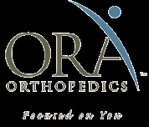
Bettendorf Clinic
In the ORA at 53rd and 18th
Fits orthotics and prosthetics and touches them up
Jess, Angie, Len

Slide 4
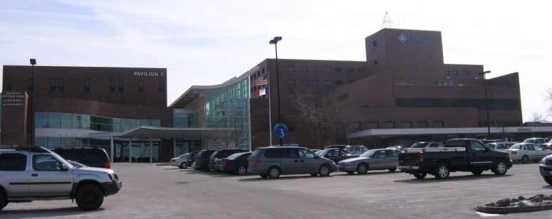
Davenport Clinic
Genesis Hospital right next to Assumption
Andy and Nick*

Slide 5
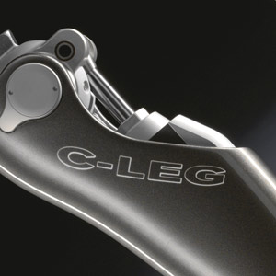
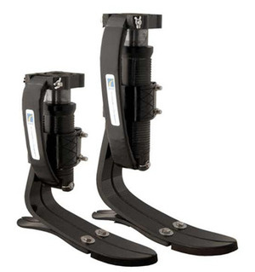
Prosthetics
Many different options for knees and feet

Slide 6
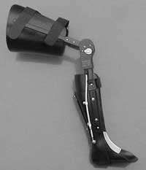
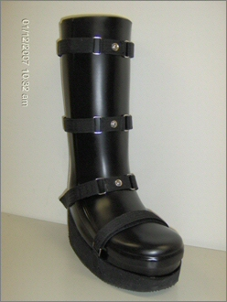
Orthotics
HKAFO, KAFO, AFO, UCB among others

Slide 7
Daily Assignments
Laboratory
Clinic
Helped set up pulls for AFOs
Built AFOs
Modified casts
Made TCC shoes
Buffed and finished product
Followed around doctors
Learned about the field
Occasionally gave insight on a prosthetic fitting

