Slide 1
Professional Internship
BY: Meghan Ferkel

Slide 2
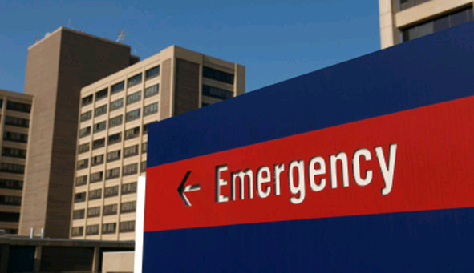
Genesis West
Emergency Room
Experience
Checked patients in and out
Filed charts, and made charts
Cleaned emergency rooms
Filled biohazard bags
Working with patients
The behind the desk work
Emergency room procedures

Slide 3
Genesis West cont.
Information Desk
Experience
Helped patients
Learned my way around the hospital
Took phone calls
Receptionist work
Working with patients and family members
Learned people skills
Receptionist work: computer programs

Slide 4
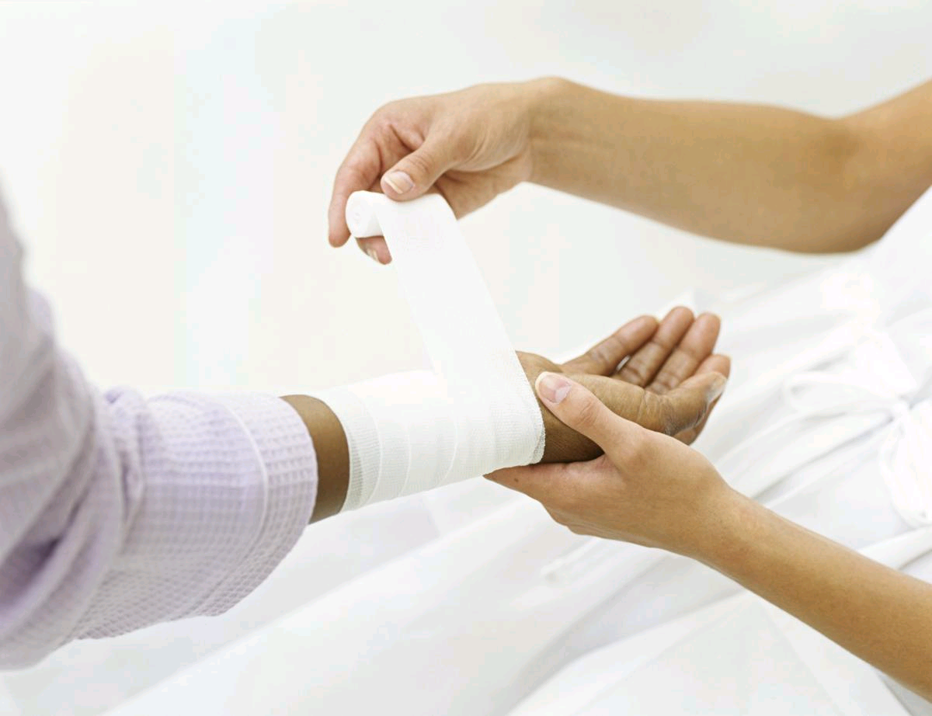
Genesis West cont.
Wound Center
Experience
Patient progress reports
Help file charts
Transport patients from their rooms
Computer programs
Helping with patients

Slide 5
Bettendorf Diabetes Center
Receptionist Work
Experience
Mailing letters
Reorganize the file room
Make packets for classes
Stuff goodie bags
Marsha Menke: Founder
Help with a big project
Learn how a fileing room works
Help patients in their classes
In case of emergency bags

Slide 6
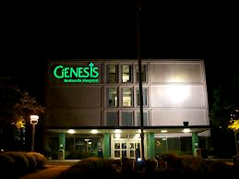
Genesis hospitals
Organized Company
Cares about their patients deeply
Runs smoothly as a business
Safe haven for unwanted children
Secure and Safe environment
Activities throughout all seasons

Slide 7
