Slide 1
Internship Program
Hannah Bankson

Slide 2
Women’s Edition Magazine
National magazine
Headquarters in Omaha, Nebraska
Offices in Cedar Rapids/Iowa City, Omaha, Denver, Quad Cities, Colorado Springs, Lincoln
Free publication
Controlled distribution
Janet Van deWalle is the founder/national publisher

Slide 3
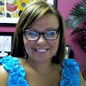
What did I do here?
Worked with Athena Gilbraith
Operations Manager
Experienced a career in journalism
Learned how to make advertisements
Wrote a story on Capri College
Attended “photo shoots”

Slide 4
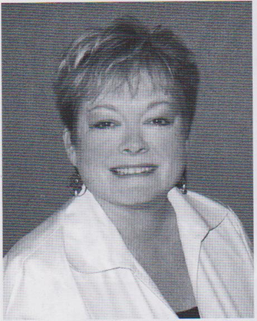
Pictures

Slide 5
Pictures

Slide 6
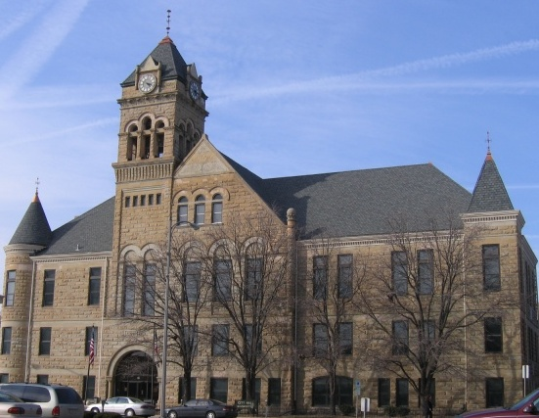
Davenport Civil Rights Commission
Administrative agency created by Chapter 2.58 of the Davenport Municipal Code for the purpose of enforcing the Davenport Civil Rights Ordinance.
Director: Judith Morrell
Housing Advisor: Kiersten Anderson
Investigative Paralegal: Michelle Neels Scheper

Slide 7
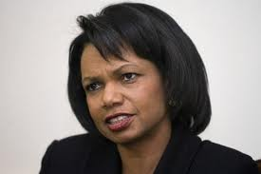
14 Protected Classes:
Age
Color
Creed
Familial Status
Gender Identity
Marital Status
Mental Disability
Physical Disability
National Origin
Race
Religion
Retaliation
Sex
Sexual Orientation

Slide 8
Protected Areas:
Employment
Housing
Public Accommodation
Education
Credit

Slide 9
What did I do here?
Learned about the complaint process
Investigated employment and housing complaints
Typed up Investigative Plans
Created Witness Questionnaires
Went through floor plans to decide if they were accessible for persons in wheelchairs
Worked on TEAPOTS for HUD

Slide 10
Continued…
Created a brochure for accessible retail stores
Took complaint calls
Created TABS for housing complaints
Sat in on a mediation
Learned about the mediation process
Created signs for local Citi Buses

